Slide 1
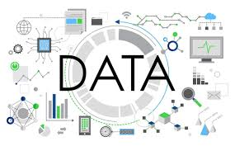
What is Data?

Slide 2
What is Data?
Data refers to raw, unorganized facts and figures that need to be processed. When data is processed, organized, or structured in a given context, it becomes meaningful and valuable, turning into information.
Or
Data is any raw fact or figure that, when processed or organized, becomes useful. Data can be numbers, text, images, etc.

Slide 3

What is a Database?

Slide 4
What is a Database?
A database is a collection of organized data that can be easily accessed, managed, and updated. Databases are used to store large amounts of data in a way that ensures data integrity, security, and ease of retrieval.

Slide 5
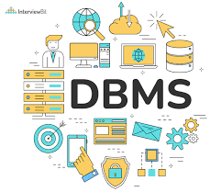
What is DBMS ?

Slide 6
What is DBMS (Database Management System)?
DBMS is a software system that allows users to create, manage, and interact with databases. It provides tools for organizing, retrieving, and maintaining data efficiently. Examples of DBMS include Oracle, MySQL, and MS Access.

Slide 7
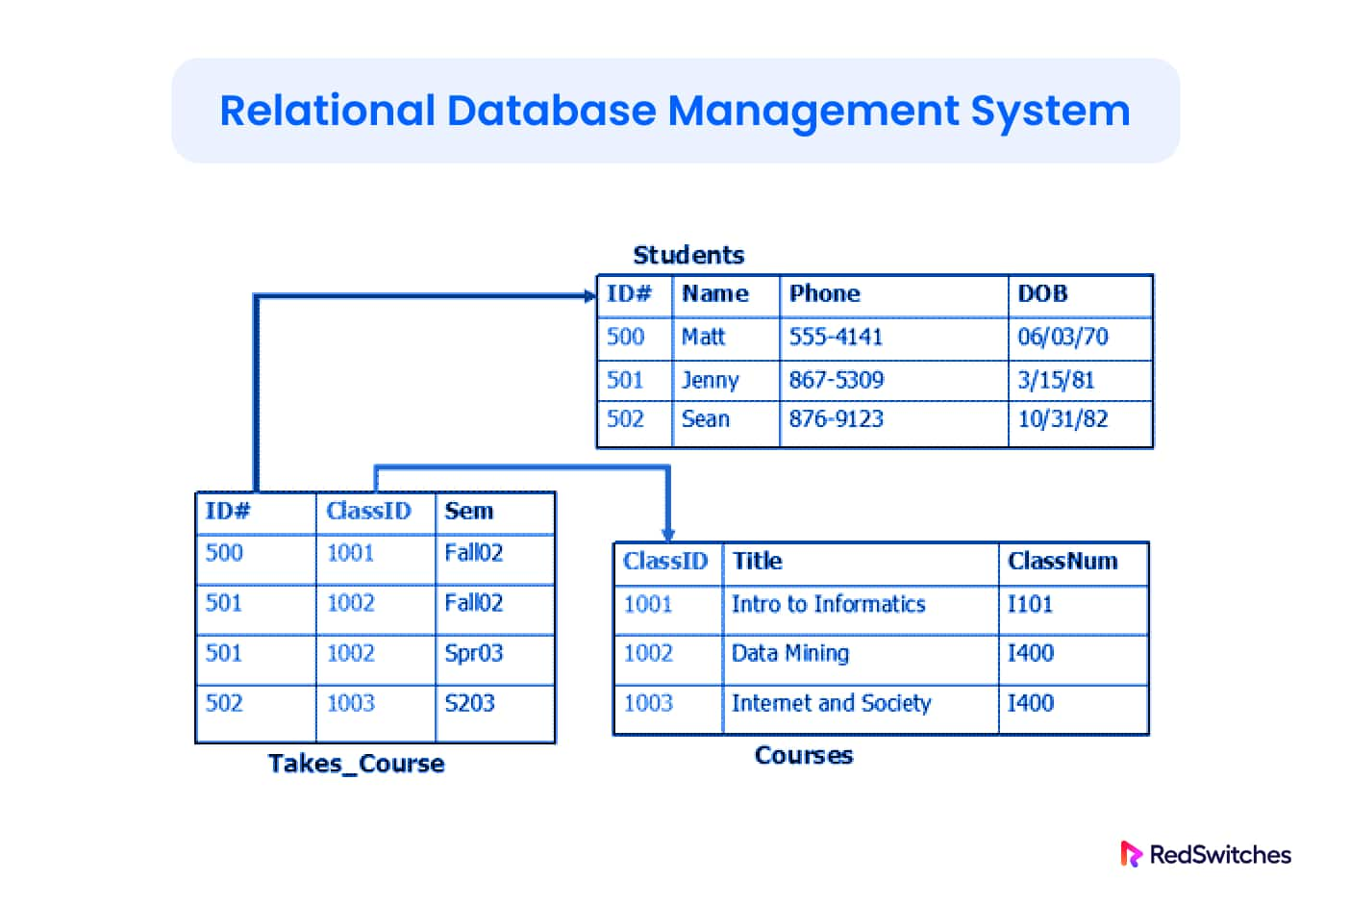
What is RDBMS ?

Slide 8
What is RDBMS (Relational Database Management System)?
RDBMS is a type of DBMS that stores data in the form of related tables, where each table consists of rows and columns. The relational model allows for data to be queried and organized in relationships, which makes it easier to retrieve and manage. Examples include MySQL, PostgreSQL, and Oracle.

Slide 9
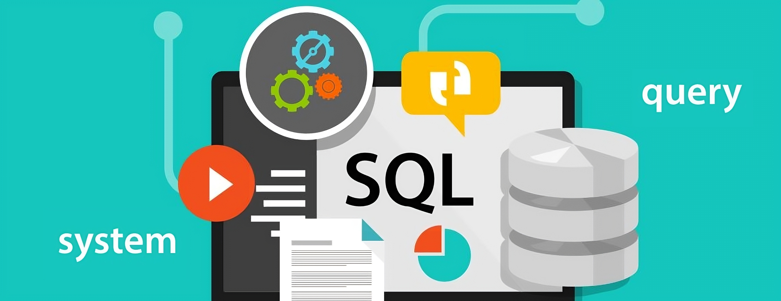
SQL (Structured Query Language)

Slide 10
What is SQL (Structured Query Language)?
SQL is a Structured Query Language used to manage and manipulate relational databases. It is used for tasks like querying data, updating records, and creating or modifying database structures.

Slide 11

SQL vs MySQL

Slide 12
SQL vs MySQL
SQL (Structured Query Language):
A language used for interacting with relational databases. It defines the operations that can be performed on the data within databases, such as SELECT, INSERT, UPDATE, and DELETE.
MySQL:
A specific RDBMS that uses SQL to manage data. MySQL is a software tool that implements the SQL standard and allows users to store, modify, and query data in a database.

Slide 13
Thank you

